Slide 1

Introduction to problem

Slide 2
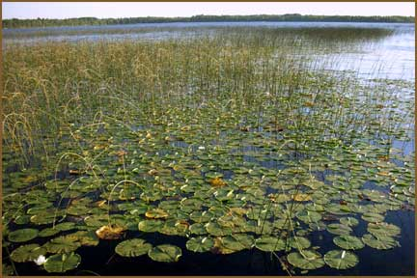
Problem
High nitrogen levels in water bodies leads to environmental problems, such as overgrowth of aquatic plants
Nitrogen levels need to be below a certain concentration to meet rules and guidelines imposed
Nitrogen levels are lowered in a WWTP (West Water Treatment Plant)

Slide 3
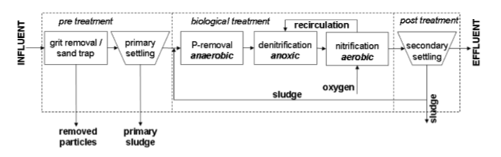
West Water Treatment Plant (WWTP)

Slide 4
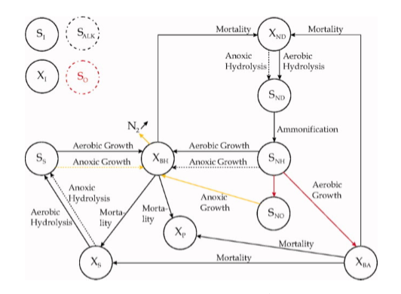
Activated Sludge Model (ASM)
The ASM models the processes in a reactor in a West Water Treatment Plant (WWTP)
The reactor is made up of an aerobic and an anoxic compartment
‘X’ signifies that it’s a biomass component
‘S’ signifies that it’s a soluble component
S_ALK and S_O are disconnected, since they play a role in most reactions

Slide 5
Nitrification and denitrification
Nitrification reaction:
Takes place in the presence of oxygen (aerobic compartment)
Converts ammonia into nitrate
2O₂ + NH₄⁺ → NO₃⁻ + H₂O + 2H⁺
Denitrification reaction:
Takes place in the absence of oxygen (anoxic compartment)
Converts nitrate into nitrogen
The nitrogen leaves the tank via air bubbles
4NO₃⁻ + 4H⁺ → 2N₂ + 5O₂ + 2H₂O

Slide 6
Control within the reactor
Ammonia is a form of nitrogen
Oxygen set-point is used to control the amount of ammonia in the reactor
In order to follow the set point, air is pumped into the reactor through air vents
Higher oxygen levels leads to a faster nitrification rate, thus causing a reduction in ammonia

Slide 7
Energy saving in a WWTP
Aeration in tanks accounts for at least 60% of the total energy costs in a WWTP
The optimal controller keeps the nitrogen levels below the given standards, while minimizing the amount of aeration energy in the WWTP

Slide 8
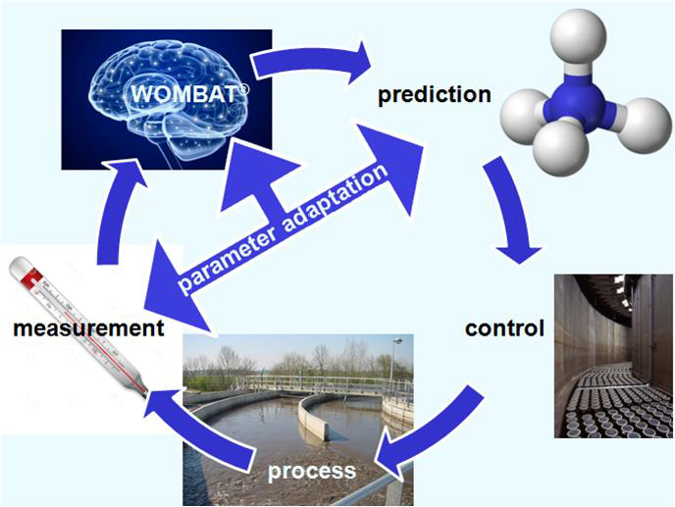
WOMBAT controller
WOMBAT stands for Witteveen+bos Optimal Model Based AeraTion
The controller uses an algorithm to calculate the oxygen set-point in the tank
Uses filters in calculations
The set-point calculation has the following inputs:
Influent flow
Oxygen measurement in reactor
Ammonia measurement in reactor
Predicts the amount of oxygen needed using the influent flow

Slide 9
Internship problems
Is the WOMBAT controller able to effectively control the nitrogen levels in a WWTP?
Is the WOMBAT (robustly) stable in the WWTP system?

Slide 10
References
Image on slide 2: https://minnesotawaters.org/blackwaterlakeinc/aquatic-plant-survey/
Image on slide 3: A. de Niet, M. van de Vrugt, H. Korving, and R.J. Boucherie (2011). Adaptive model based control for wastewater treatment plants. Witteveen+Bos Consulting Engineers, Universiteit Twente.
Image on slide 4: R. David, A. Vande Wouwer, J.-L. Vasel, and I. Queinnec. Robust control of the activated sludge process. Biological progress, 25(3):701-708, 2009.
Image on slide 8: Witteveen en Bos image, taken from assignment description document.

